Slide 1

Introduction and Installation
Emerging Technology : Flutter
Week 1
Program Studi Teknik Informatika
Fakultas Teknik – Universitas Surabaya

Slide 2

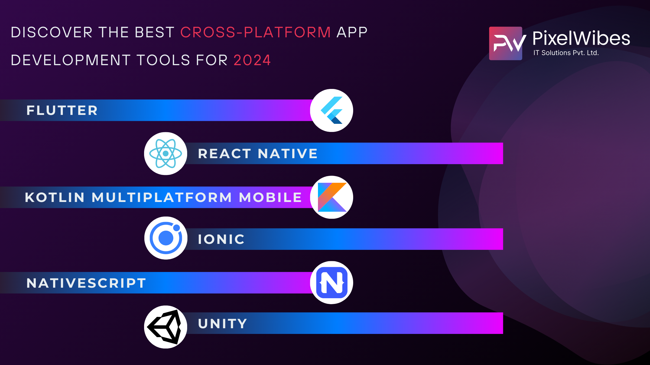
Why Flutter

Slide 3
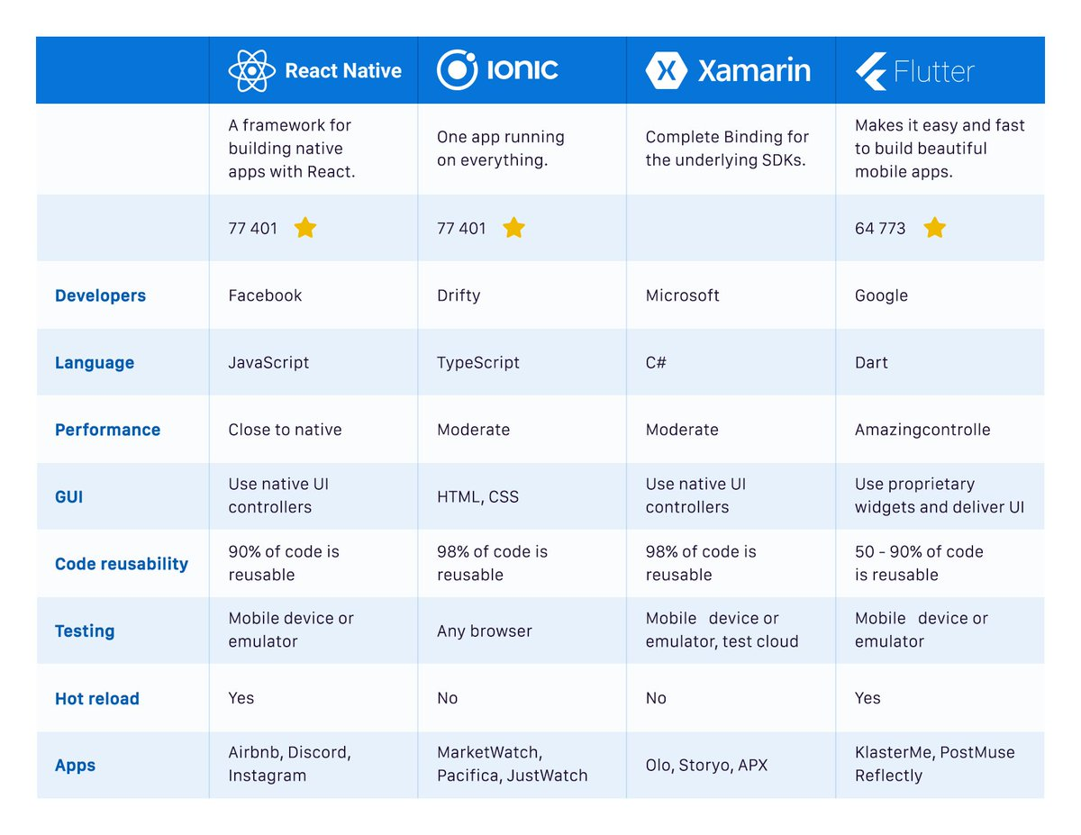
Compari son

Slide 4
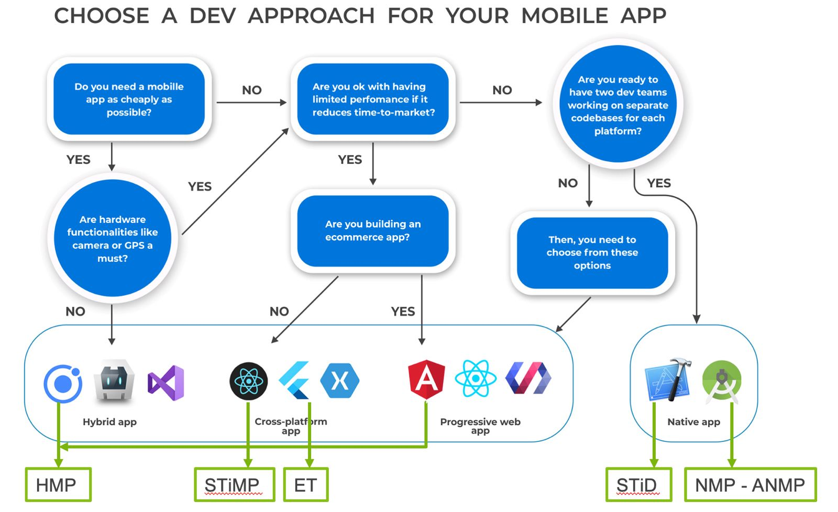
Why Flutter

Slide 5
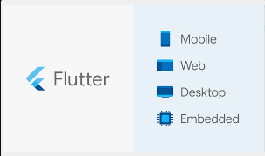
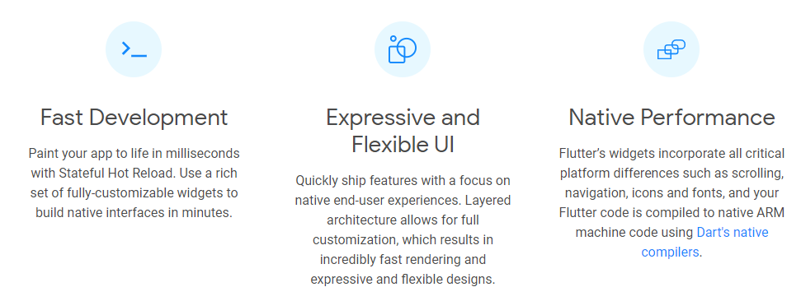
What is Flutter
Flutter is Google’s UI toolkit for building beautiful, natively compiled applications for mobile, web, and desktop from a single codebase.

Slide 6

INSTALLATION (USING VS CODE)
01
Recommended by Flutter

Slide 7
Installation
Go here https://docs.flutter.dev/install/with-vs-code
Follow the steps carefully. You need additional resources like git, Visual Studio code, Flutter extension for Visual Studio Code, Android Studio, XCode (for mac)

Slide 8
INSTALLATION (WINDOWS)
01
For Mac user please follow the instructions in https://docs.flutter.dev/get-started/install/macos

Slide 9
Installation
https://flutter.dev/docs/get-started/install/windows
1. Download and extract to a certain directory. Ex: c:\flutter . Or clone via git (d:\flutter)
git clone https://github.com/flutter/flutter.git -b stable
2. Open Edit environment variables for your account. Add path you set in no 1 + “\bin” -> d:\flutter\bin
3. Open cmd . Run flutter doctor
to view the environment for flutter development in your computer

Slide 10
Installation (for Mac User)
For Mac user please follow the instructions in https://docs.flutter.dev/get-started/install/macos
To add flutter command to environment variable, please follow the Stack Overflow solution here: https://stackoverflow.com/a/53901244

Slide 11
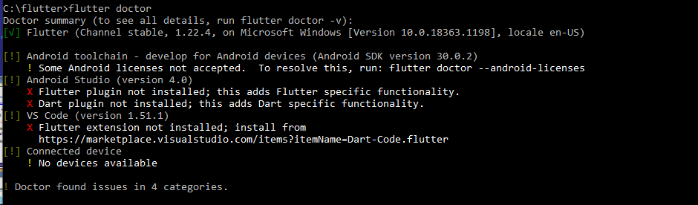
Installation (2) – flutter doctor
Example view after running flutter doctor:
Need to run flutter doctor --android-licenses
Need to install flutter plugin and dart plugin in andstud . OR
Install flutter extension in VS Code

Slide 12
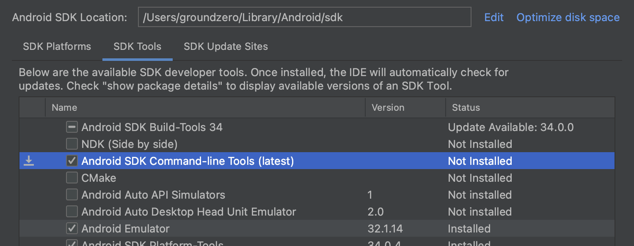
Installation (2) – flutter doctor
You can also install Android SDK Command-line tools through Android Studio

Slide 13
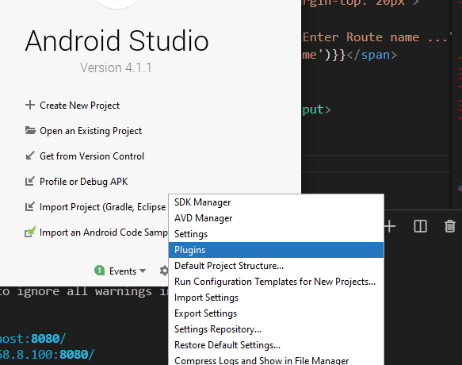
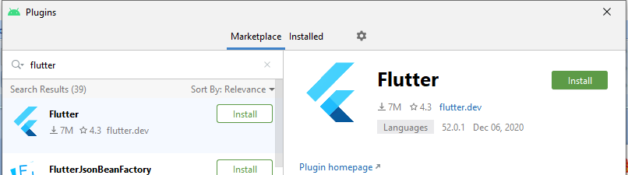
Installation (3) – Plugin anstud
Open Configure-plugin , Search ‘flutter’ and ‘dart’, install

Slide 14
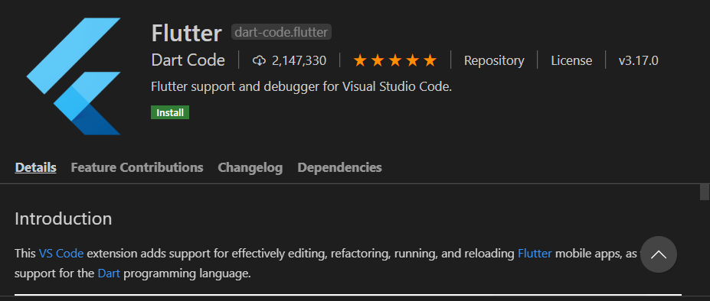
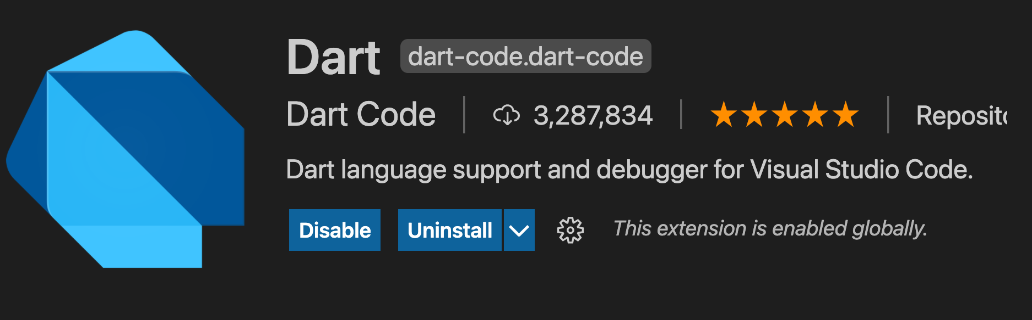
Installation (4) – vscode extension
Search “flutter” and “Dart” in extension Or from https://marketplace.visualstudio.com/items?itemName=Dart-Code.flutter

Slide 15
HELLO WORLD
02

Slide 16
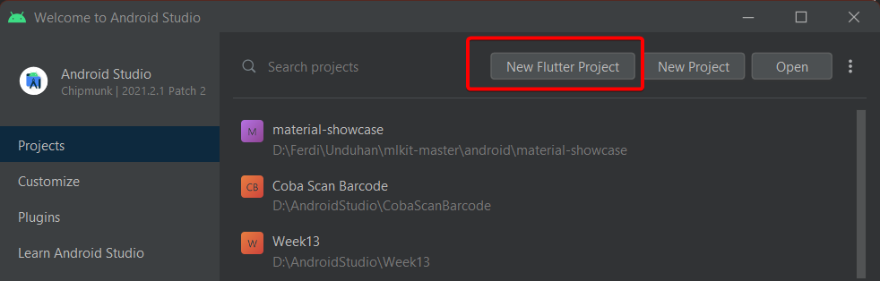
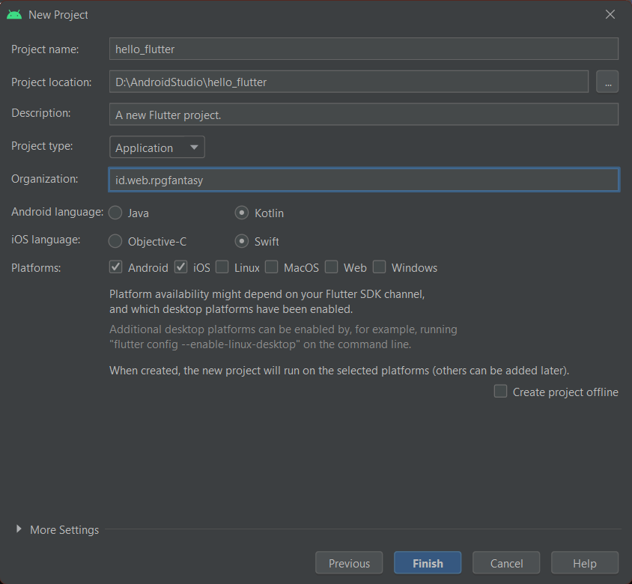
First Flutter Project (anstud)
Project name only allows lowercase and underscore

Slide 17
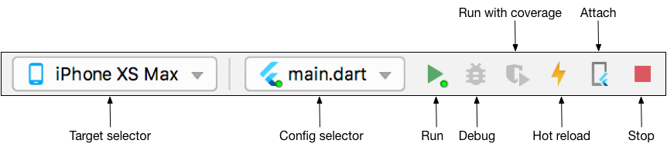
Run Flutter Project (anstud)

Slide 18
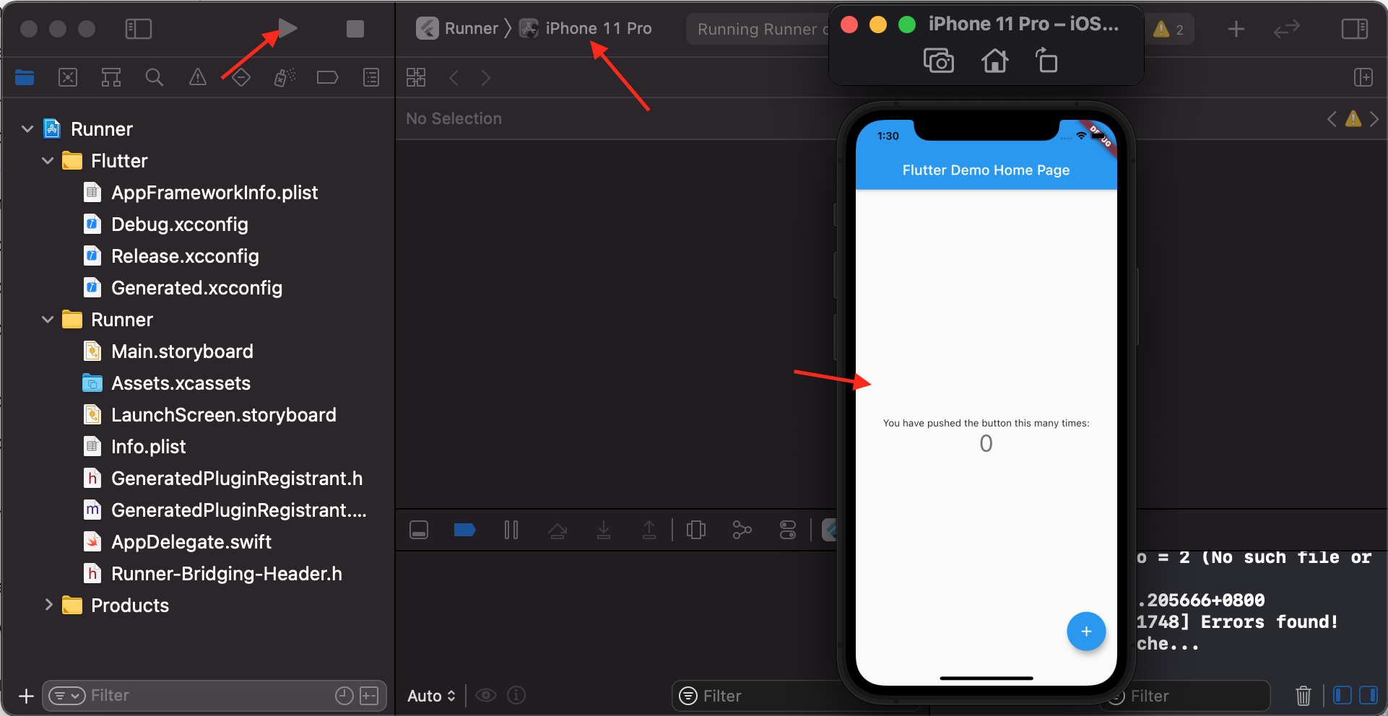
Run Flutter Project (XCode)

Slide 19
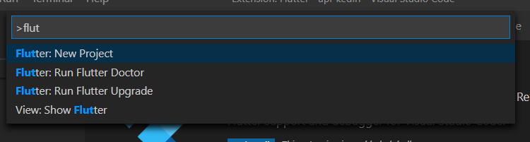
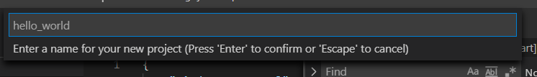
First Flutter Project (VS Code)
Open vs code, press Ctrl + Shift + P to open Command palette
find Flutter: new project
Input project name
Choose project location

Slide 20
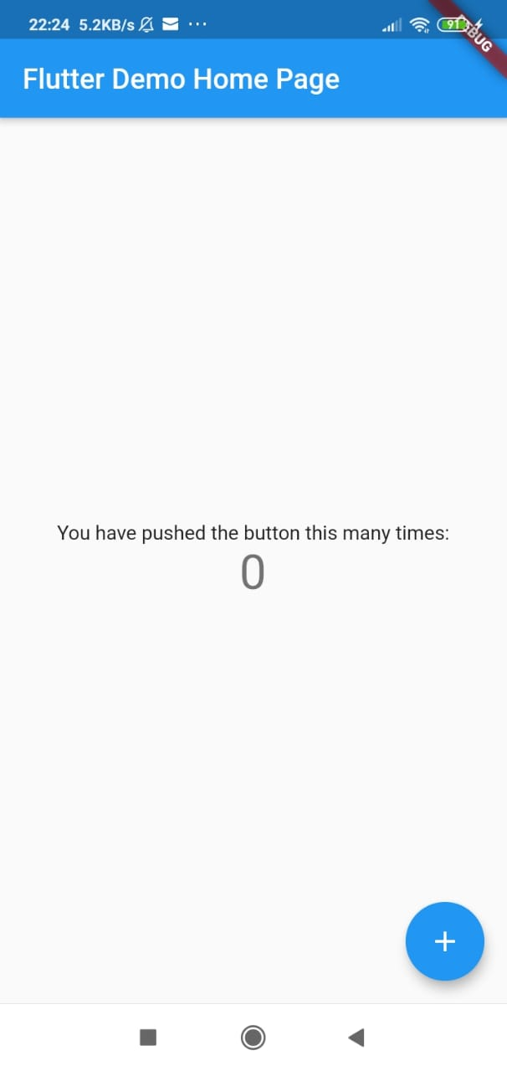
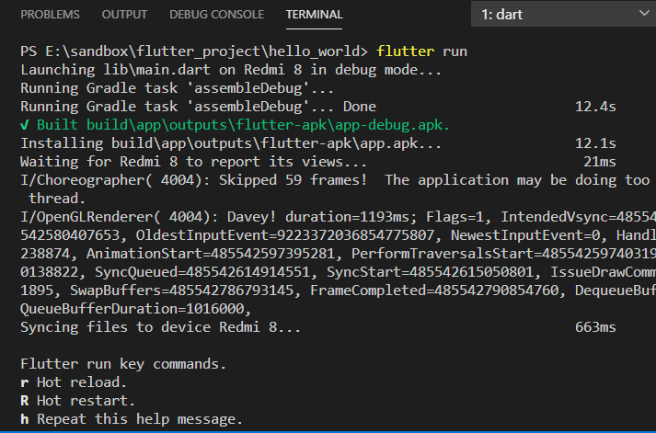
Run Flutter Project (VS Code)
Open emulator or
connect your device to your computer
via USB
Open vscode terminal, run flutter run

Slide 21
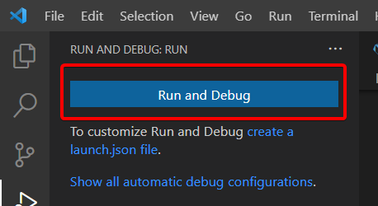
Run Flutter Project (VS Code)
Or, if available from the latest plugin, simply press F5 to run the project or click Run and Debug button

Slide 22
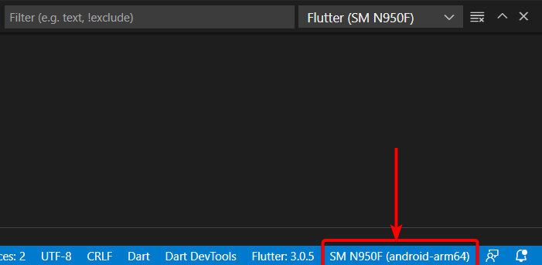
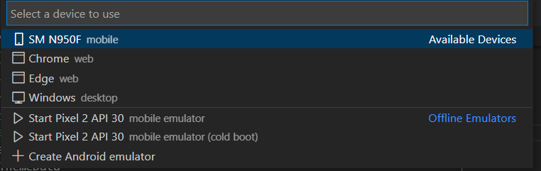
Switch Device (VS code)
If you want to switch device to test the project, open the Command Palette (Ctrl + Shift + P) and search for Flutter: Select Device
Or click the current device name at bottom right corner of VS Code
Select from list of available devices, then run your project

Slide 23
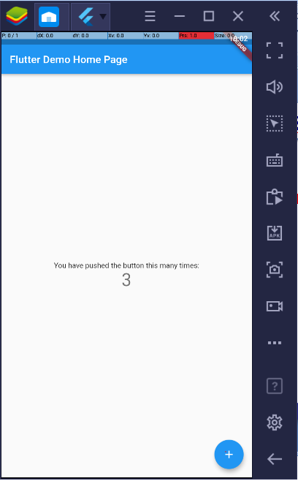
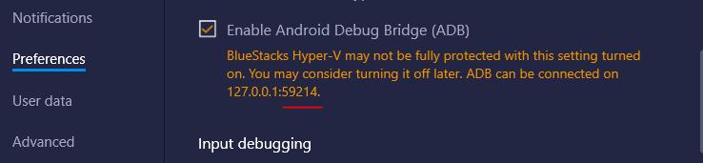
Run Flutter with bluestack (vs code)
Run bluestack.
Open setting – preference section adb
Open cmd run : adb connect localhost:[listed port]
Open vscode terminal, run flutter run

Slide 24
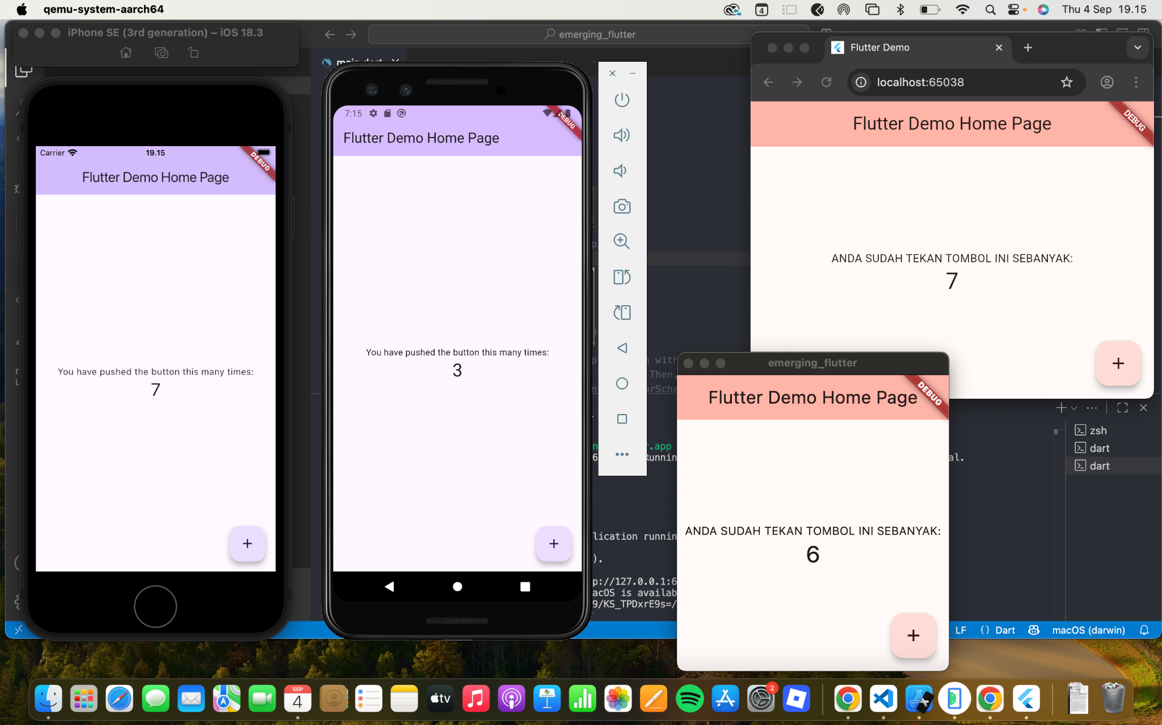
iOS
Android
Chrome (Web)
MacOs (Ddesktop)

Slide 25
The hot reload
Flutter have hot reload feature.
Open /lib/main.dart
Change the primary swatch color in line 31
colorScheme: ColorScheme.fromSeed(seedColor: Colors.green)
Activate the VS code terminal by focusing mouse click on it. Then push r key, and see the changing in your emulator/device
Or, using latest plugin, simply save (Ctrl + S) your file
It will perform hot reload automatically
You can also force hot reload by pressing Ctrl + F5 (don’t forget to save your file first)

Slide 26
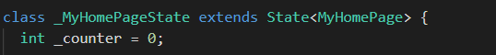
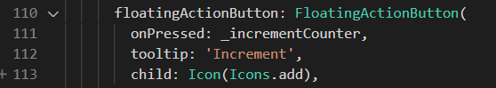
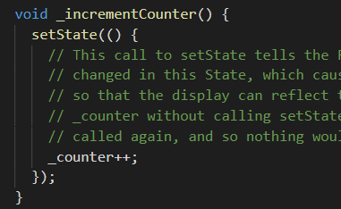
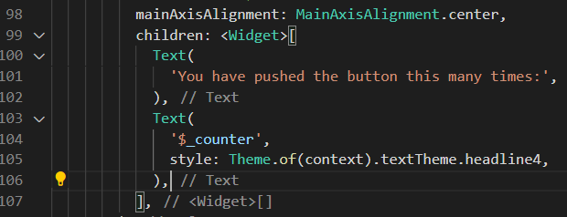
About the click in FAB
We have variabel _counter
In FAB onPressed calling _incrementCounter
function
here _counter increased by 1
setState will refresh the page
after _counter increased.
and updating value of the
widget text

Slide 27
THE DART
03

Slide 28
Dart
Dart is the flutter programming language
Dart is an object-oriented programming (OOP) language, has a class-based style, and uses a
C-style syntax. If you are familiar with the C#, C++, Swift, Kotlin, and Java/JavaScript languages,
you will be able to start developing in Dart quickly.
Play around here: https://dart.dev/#try-dart

Slide 29
Variable Declaration
In Dart, all variables are declared public (available to all) by default, but by starting the variable name with an underscore (_), you can declare it as private. By declaring a variable private, you are saying it cannot be accessed from outside classes/functions; in other words, it can be used only from within the declaration class/function.
What if the value of a variable doesn’t need to change? Begin the declaration of the variable with
final or const. Use final when the value is assigned at runtime (can be changed by the user). Use
const when the value is known at compile time (in code) and will not change at runtime.
// Declared without specifying the type - Infers type
var filter = 'company';
// Declared by type
String filter = 'company';
// Uninitialized variable has an initial value of null
String filter;
// Value will not change
final filter = 'company';
// or
final String filter = 'company';
// or
const String filter = 'company';
// or const String filter = 'company' + filterOption;
// Public variable (variable name starts without underscore)
String userName = 'Sandy';
// Private variable (variable name starts with underscore)
String _userID = 'XW904';

Slide 30
Numbers
Declaring variables as numbers restricts the values to numbers only. Dart allows numbers to be int (integer) or double. Use the int declaration if your numbers do not require decimal point precision, like 10 or 40. Use the double declaration if your numbers require decimal point precision, like 50.25 or 135.7521. Both int and double allow for positive and negative numbers, and you can enter extremely large numbers and decimal precision since they both use 64-bit (computer memory) values.
// Integer
int counter = 0;
double price = 0.0;
price = 125.00;

Slide 31
Strings
Declaring variables as String allows values to be entered as a sequence of text characters. To add a single line of characters, you can use single or double quotes like 'car' or "car". To add multiline characters, use triple quotes, like "'car"'. Strings can be concatenated (combined) by using the plus (+) operator or by using adjacent single or double quotes.
// Strings
String defaultMenu = 'main';
// String concatenation
String combinedName = 'main' + ' ' + 'function';
String combinedNameNoPlusSign = 'main' ' ' 'function';
// String multi-line
String multilineAddress = '''
123 Any Street
City, State, Zip
''';

Slide 32
Boolean
Declaring variables as bool (Boolean) allows a value of true or false to be entered.
// Booleans
bool isDone = false;
isDone = true;

Slide 33
Lists
Declaring variables as List (comparable to arrays) allows multiple values to be entered; a List is an ordered group of objects. In programming, an array is an iterable (accessed sequentially) collection of objects, with each element accessible by the index position or a key. To access elements, the List uses zero-based indexing.
A List can be of fixed length or growable, depending on your needs. By default, a List is created as growable by using List() or []. To create a fixed-length List, you add the number of rows required by using this format: List(25).
// List Growable
List contacts = List();
// or
List contacts = [];
List contacts = ['Linda', 'John', 'Mary'];
// List fixed-length
List contact = List(25);
// Lists - In Dart List is an array
List listOfFilters = ['company', 'city', 'state'];
listOfFilters.forEach((filter) {
print('filter: $filter');
});
The $ sign before the variable converts the expression value to a string.

Slide 34
Maps
Maps are invaluable in associating a List of values by a Key and a Value. Mapping allows recalling
values by their Key ID. The Key and Value can be any type of object, such as String, Number, and so
on. Keep in mind that the Key needs to be unique since the Value is retrieved by the Key.
// Maps - An object that associates keys and values.
// Key: Value - 'KeyValue': 'Value'
Map mapOfFilters = {'id1': 'company', 'id2': 'city', 'id3': 'state'};
// Change the value of third item with Key of id3
mapOfFilters['id3'] = 'my filter';
print('Get filter with id3: ${mapOfFilters['id3']}');
// Result from print statement
// Get filter with id3: my filter

Slide 35
Runes
In Dart, declaring variables as Runes are the UTF-32 code points of a String. Emojis, anyone?
Unicode defines a numeric value for each letter, digit, and symbol. Dart uses the sequence of UTF-16 code units to represent a 32-bit Unicode value from a string require a special syntax (\uXXXX). A Unicode code point is \uXXXX, where XXXX is a four-digit hexadecimal value. Runes return the integer value of the Unicode; then you use String.fromCharCodes() to allocate a new String for the specified charCode.
// Emoji smiling angel Unicode is u+1f607
// Remove the Plus sign and replace with curly brackets
Runes myEmoji = Runes('\u{1f607}');
print(myEmoji);
// Result from print statement
// (128519)
print(String.fromCharCodes(myEmoji));

Slide 36
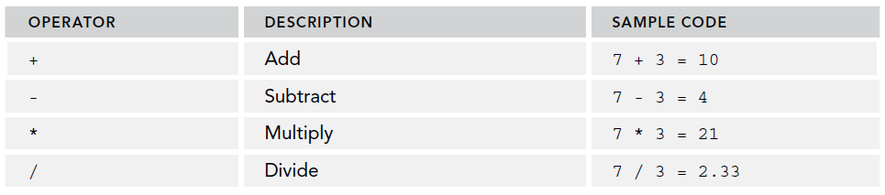
Arithmetic Operator

Slide 37
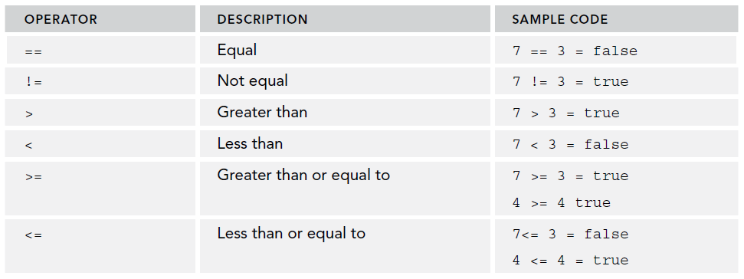
Equality and Relational Operator

Slide 38
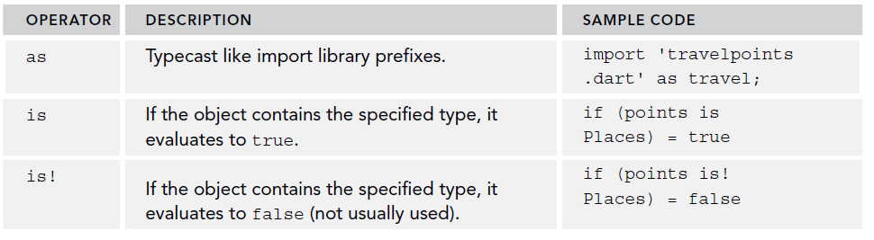
Type Test Operator

Slide 39
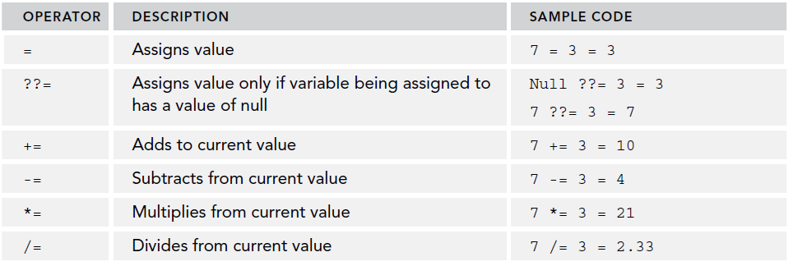
Assigment Operator

Slide 40
Assigment Operator
// ??= (assign only if the variable is null)
int? n1; // n1 is null
n1 ??= 3; // n1 becomes 3
int? n2 = 7; // n2 is not null
n2 ??= 3; // no change → n2 stays 7

Slide 41
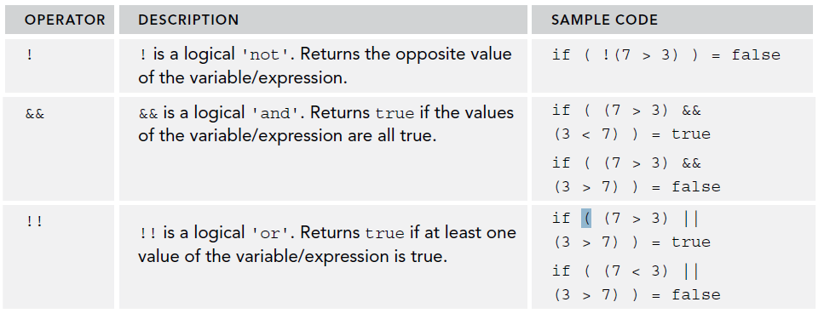
Logical Operator

Slide 42
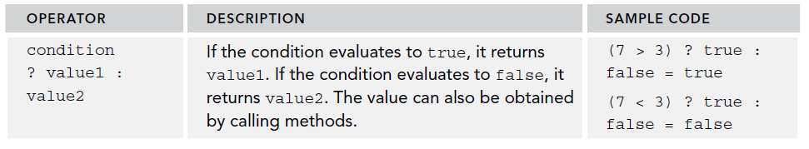
Conditional Expression

Slide 43
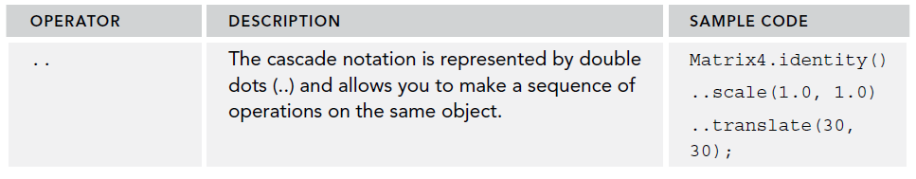
Cascade notation

Slide 44
The Logic Flow
To control the logic flow of the Dart code, take a look at the following flow statements:
➤➤ if and else are the most common flow statements; they decide which code to run by comparing multiple scenarios.
➤➤ The ternary operator is similar to the if and else statements but used when only two choices are needed.
➤➤ for loops allow iterating a List of values.
➤➤ while and do-while are a common pair. Use the while loop to evaluate the condition before running the loop, and use do-while to evaluate the condition after the loop.
➤➤ while and break are useful if you need to stop evaluating the condition in the loop.
➤➤ continue is for when you need to stop the current loop and start the next loop iteration.
➤➤ switch and case are alternatives to the if and else statements, but they require a default clause.

Slide 45
Function
Functions are used to group reusable logic. A function can optionally take parameters and return values. If the function executes a single expression, you can use the arrow (=>) syntax. All functions return a value by default, and if no return statement is specified, Dart automatically appends to the function body the return null statement, which is implicitly added for you.
// Functions - Our main() is a function
void main() => runApp(new MyApp());
// Function - pass value and return value
bool orderEspresso(int howManyCups) {
print('Cups #: $howManyCups');
return true;
}

Slide 46
Import Packages
To use an external package, library or an external class, use the import statement. Separating code logic into different class files allows you to separate and group code into manageable objects. The import statement allows access to external packages and classes. It requires only one argument, which specifies the uniform resource identifier (URI) of the class/library. If the library is created by a package manager, then you specify the package: scheme before the URI. If importing a class, you specify the location and class name or the package: directive.
// Import the material package
import 'package:flutter/material.dart';
// Import external class
import 'charts.dart';
// Import external class in a different folder
import 'services/charts_api.dart';
// Import external class with package: directive
import 'package:project_name/services/charts_api.dart';

Slide 47
Asynchronous
A Future in Dart represents a value that will be available later. Similar like a “promise” of a result.
It might complete successfully with some data, or fail with an error.
Example:
// Here, fetchUser returns a Future<String>. The result "Andre" will only be available after 2 seconds.
Future<String> fetchUser() {
return Future.delayed(Duration(seconds: 2), () => "Andre");
}

Slide 48
Asynchronous
You mark a function with async when it contains asynchronous code (i.e., code that returns Futures and may pause while waiting).
An async function always returns a Future, even if you return a plain value.
Example:
// Even though we just print something, because the function is marked async, its return type is wrapped in a Future.
Future<void> printUser() async {
String user = await fetchUser();
print(user);
}

Slide 49
Asynchronous
Inside an async function, you can use await to pause execution until the Future completes.
It lets you write asynchronous code that looks more like synchronous code.
Example:
void main() async {
print("Fetching user...");
String user = await fetchUser(); // waits here until the future completes
print("User: $user");
}
Output: Fetching user...
(2 seconds later)
User: Andre

Slide 50
Asynchronous
// Async and await Function with Future - return value of integer
Future<int> totalCookiesCount() async {
int cookiesCount = await lookupTotalCookiesCountDatabase(); // Returns 33
return cookiesCount;
}
// Async method to call web server
Future<int> lookupTotalCookiesCountDatabase() async {
// In a real world app we call the web server to retrieve live data
return 33;
}
// User pressed button
totalCookiesCount()
.then((count) {
print('cookiesCount: ${count}');
});
print('This will print before cookiesCount');
// This will print before cookiesCount
// cookiesCount: 33

Slide 51
EXERCISE
04

Slide 52
Exercise
Modify the default app , by adding text below the counting text. The text consist of a number of smile emojis. The number of emojis equal to the _counter value.
-----------------------------------------------------------------------------------------------
Can you replace the smile emoji with angry emoji in emoji number 5, 10, 15, etc.. ?
Also, add text to display your NRP and Name.

Slide 53
Homework
Install Flutter on your computer.
Take a selfie of you and your computer screen that shows that you are ready to create Flutter projects.
Your screen must show the IDE (either Android Studio or VS Code) and emulator/Bluestack/browser that shows the result of your week 1 project (including the exercise).
Submit at ULS before deadline.

Slide 54



